Slide 1

STUDENT MANAGEMENT
SYSTEM
PRESENTING BY
P.SHREESHA

Slide 2
INTRODUCTION
The 'Student Management System' is designed to keep track of the information of the Administration, Students, Trainer, Course and Payment.
The student management system allows authorized members to access the record of academically registered students. It can be used in various educational institutes across the globe and simplifies working of institutes
The system maintains records of students, trainer,courses modules.

Slide 3
MODULES
ADMIN
STUDENT
TRAINER
COURSE
PAYMENT
CART

Slide 4
SOFTWARE
BACK-END
Spring-Boot
JPA
Rest API
DATABASE
My-SQL
FRONT-END
Angular
Node js
Visual studio code
Type Script

Slide 5
SPRING BOOT
Spring Boot is an open source Java-based framework used to create a micro Service.
Advantages:
Spring Boot offers the following advantages to its developers
Easy to understand and develop spring applications
Increases productivity
Reduces the development time

Slide 6
REST API
Representational State Transfer (REST) is an architectural style that defines a set of constraints to be used for creating web services.
REST API is a way of accessing web services in a simple and flexible way without having any processing.

Slide 7
Java Persistence API
A JPA (Java Persistence API) is a specification of Java which is used to access, manage, and persist data between Java object and relational database.
It is considered as a standard approach for Object Relational Mapping.
JPA can be seen as a bridge between object-oriented domain models and relational database systems.

Slide 8
POSTMAN
Postman is an API(application programming interface) development tool which helps to build, test and modify APIs.
It has the ability to make various types of HTTP requests(GET, POST, PUT, PATCH), saving environments for later use, converting the API to code for various languages(like JavaScript, Python).

Slide 9
ANGULAR
Angular is a platform and framework for building single-page client applications using HTML and Type Script.
Angular is written in Type Script. It implements core and optional functionality as a set of Type Script libraries that you import into your applications.
The basic building blocks of the Angular framework are Angular components that are organized into
Ng Modules.

Slide 10
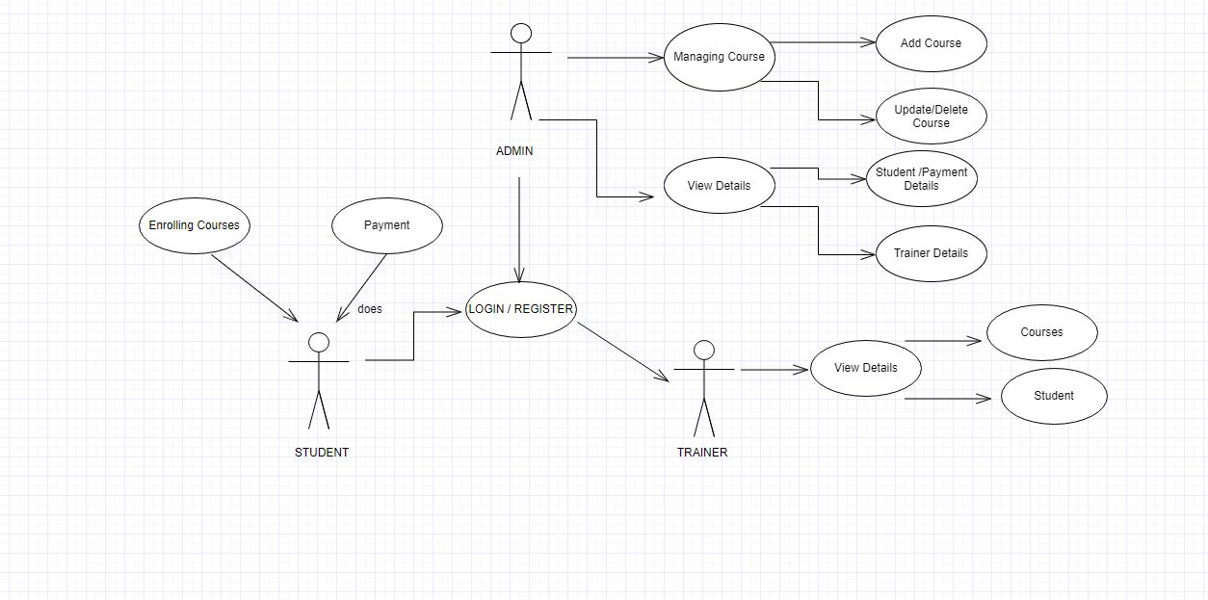
USE CASE – DIAGRAM

Slide 11
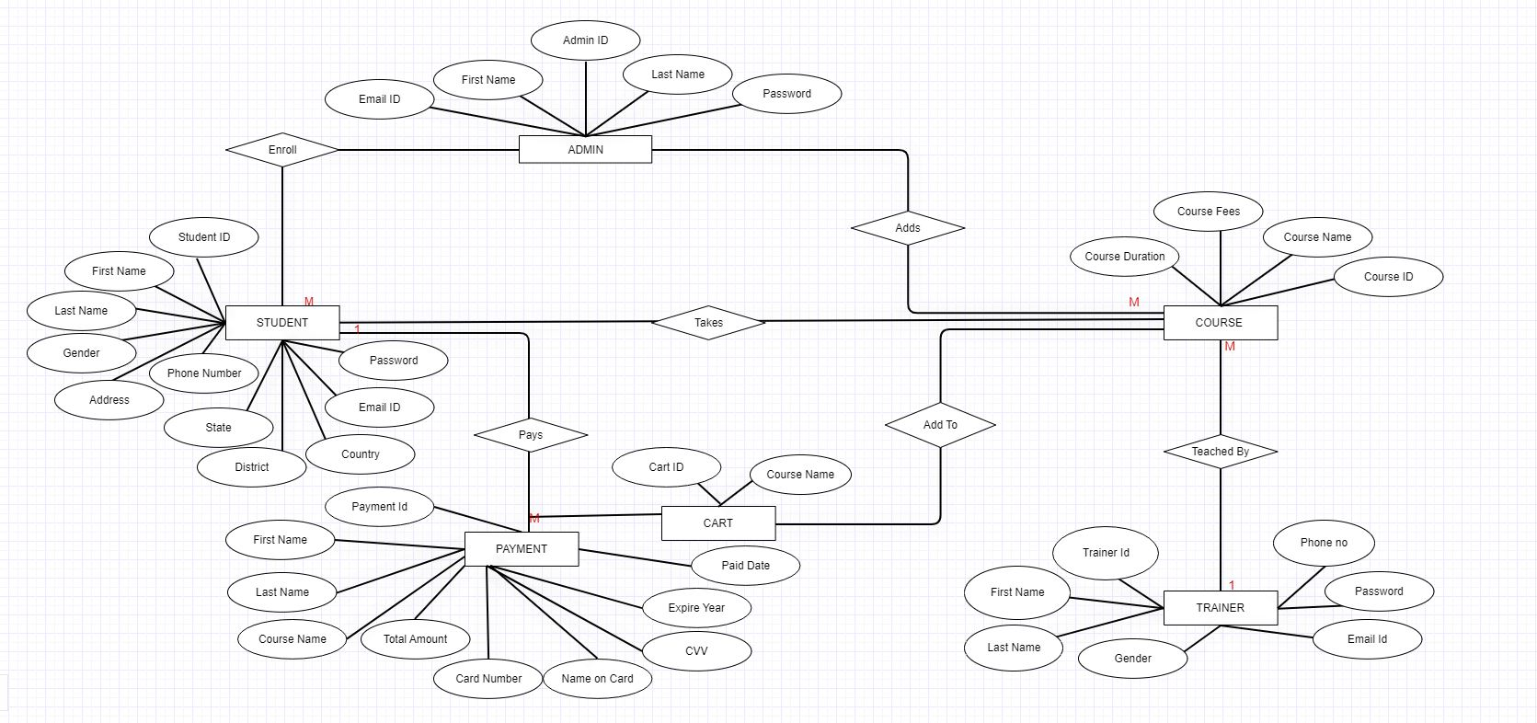
ER - DIAGRAM

Slide 12
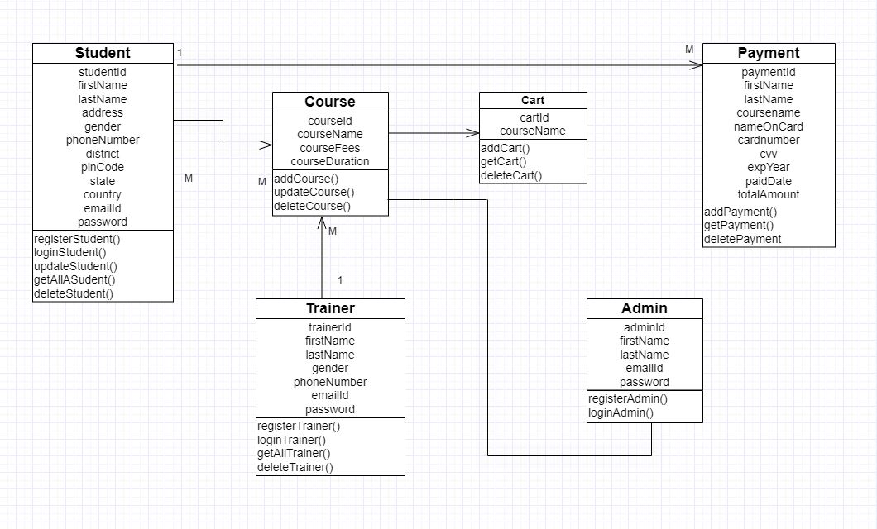
CLASS DIAGRAM

Slide 13
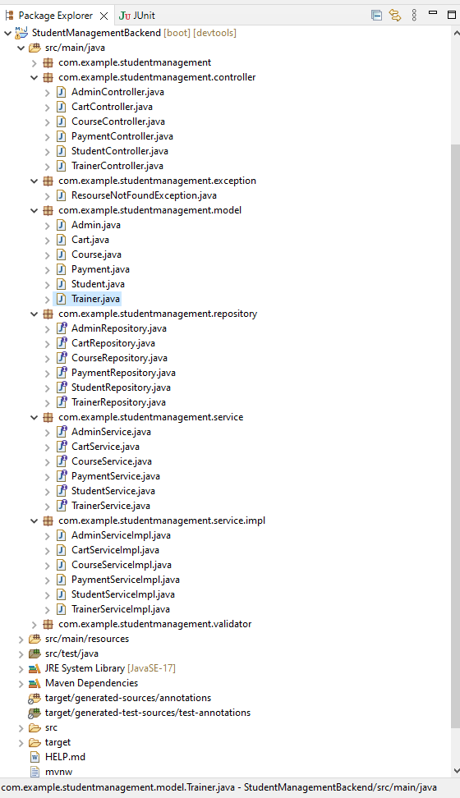

Slide 14
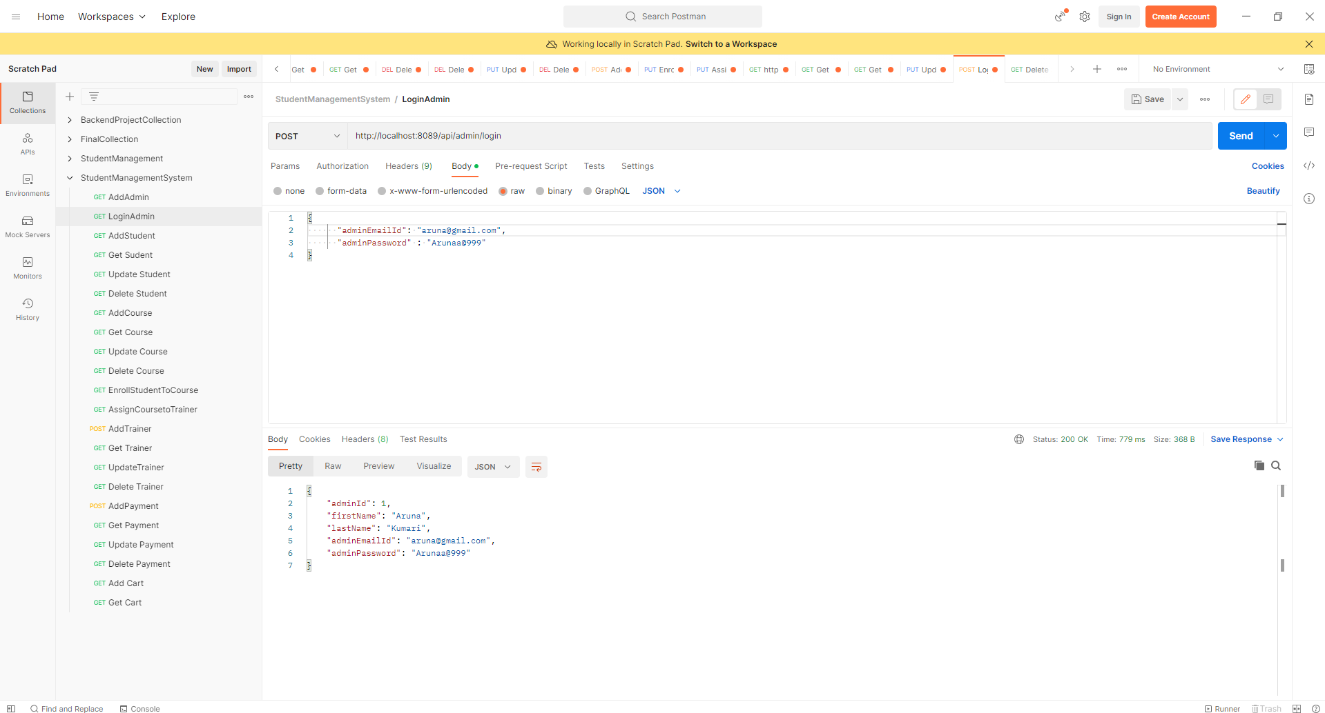

Slide 15
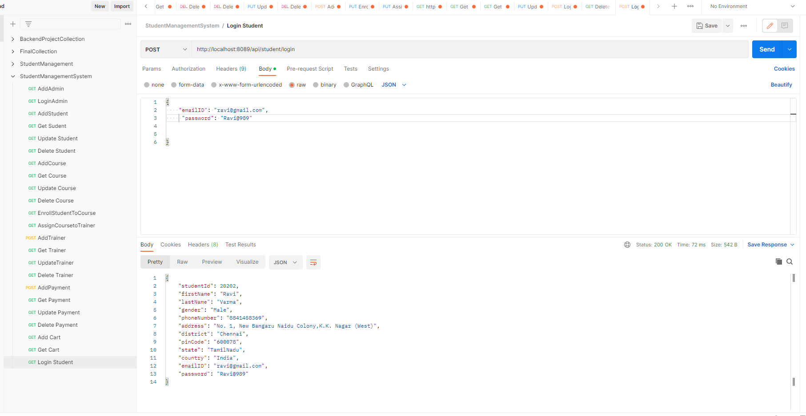

Slide 16
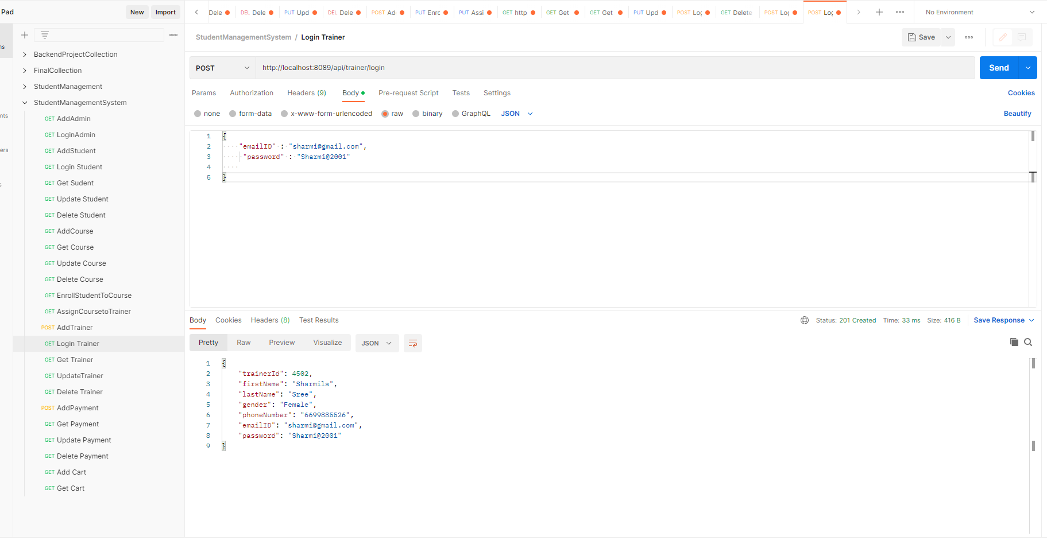

Slide 17
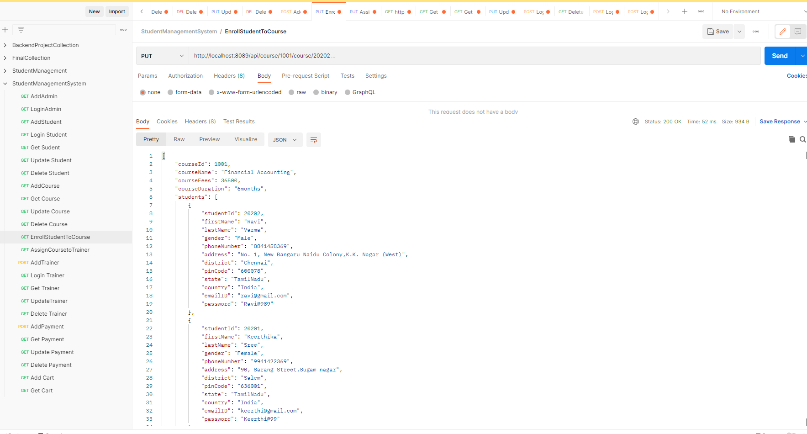

Slide 18
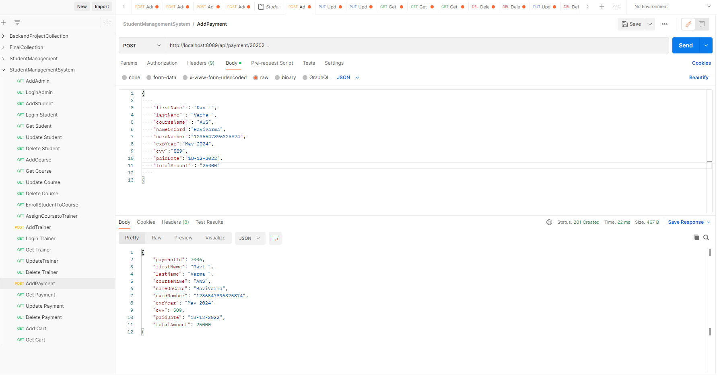

Slide 19
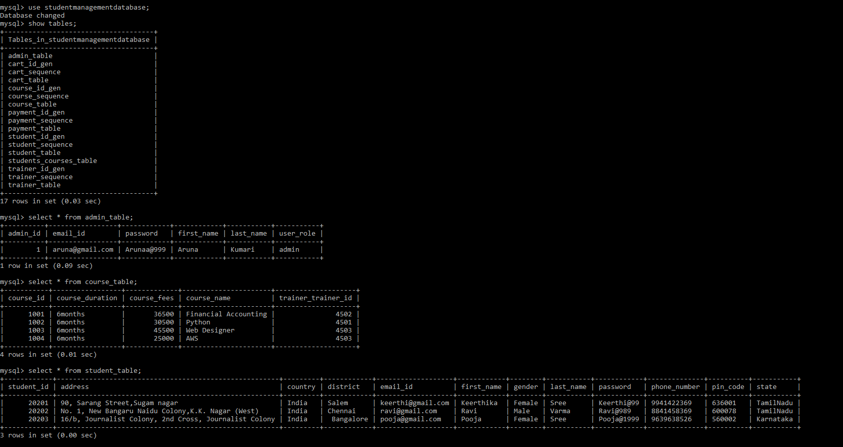

Slide 20
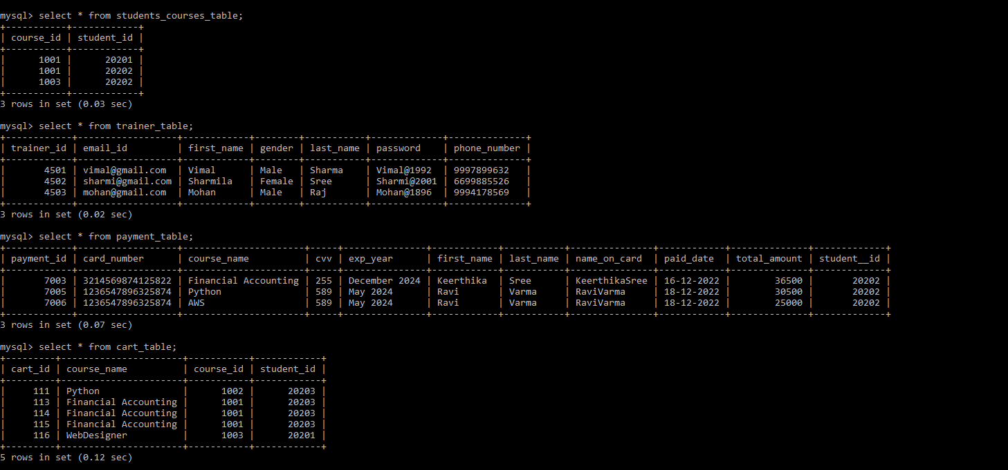

Slide 21
ADMIN

Slide 22
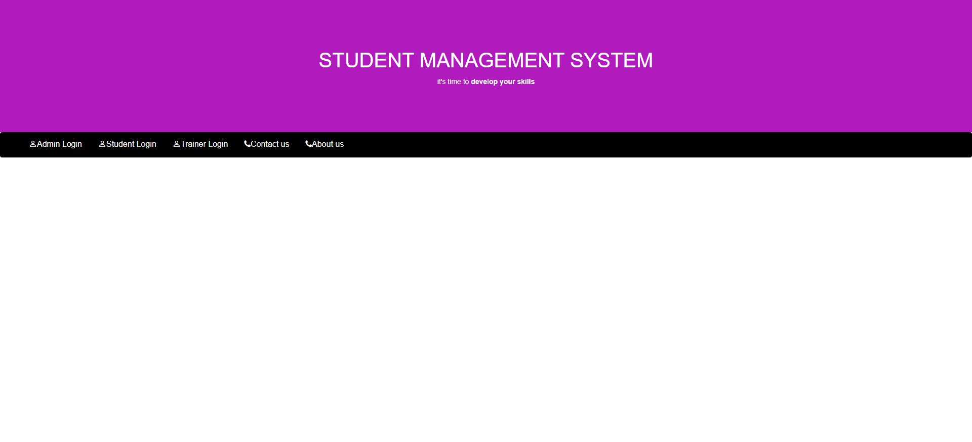

Slide 23
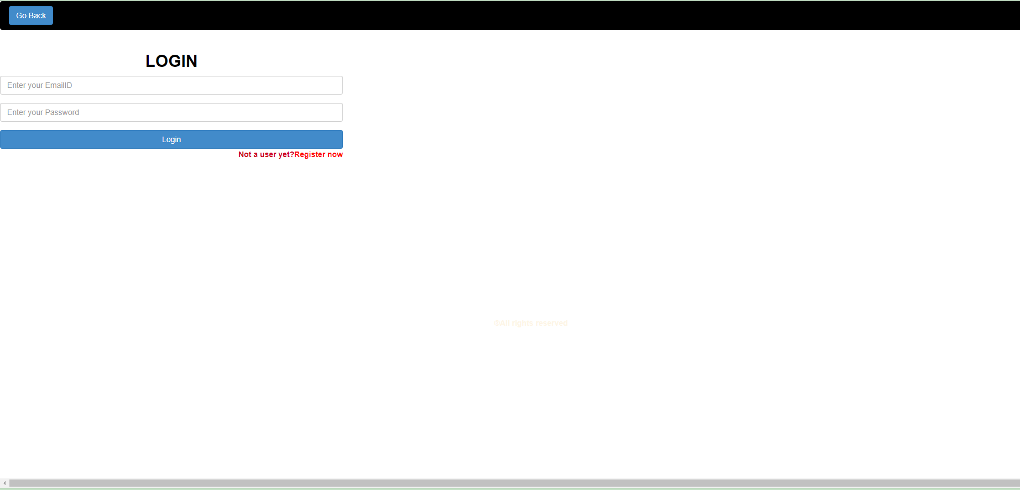
Admin Login

Slide 24
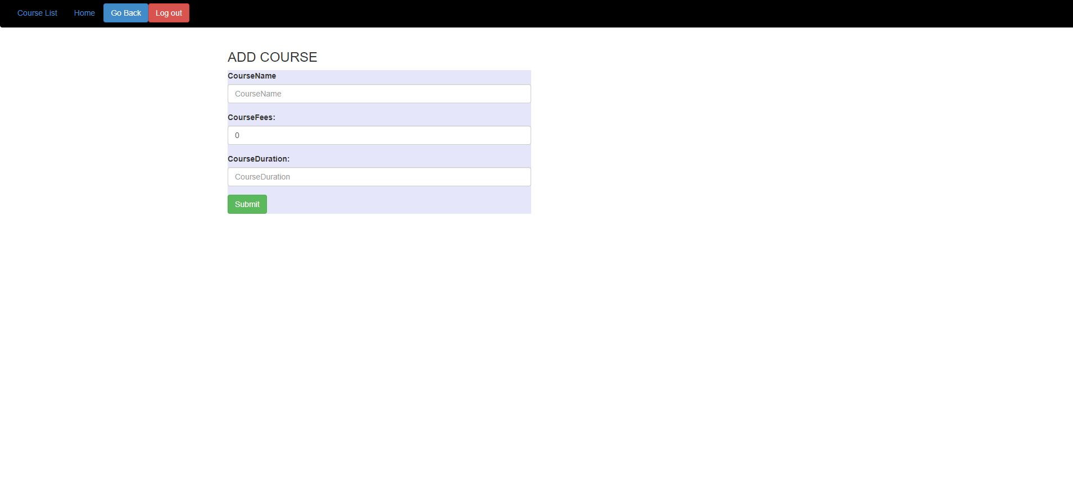
Add Course

Slide 25
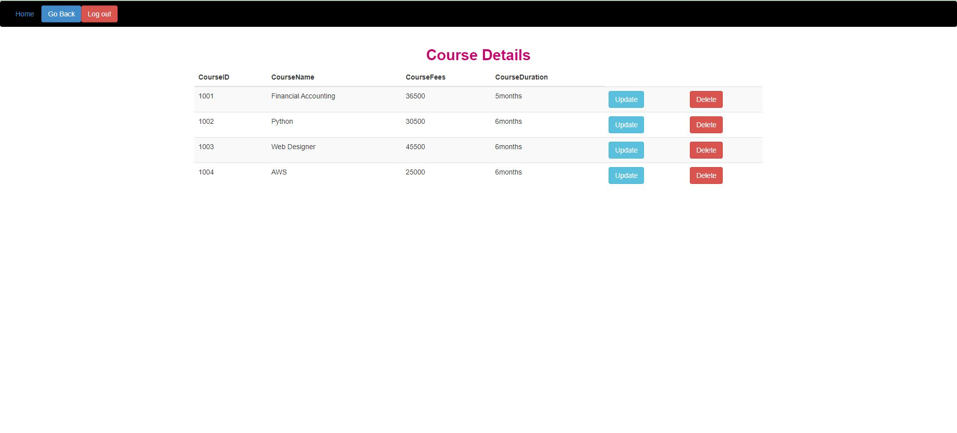
Course Details

Slide 26
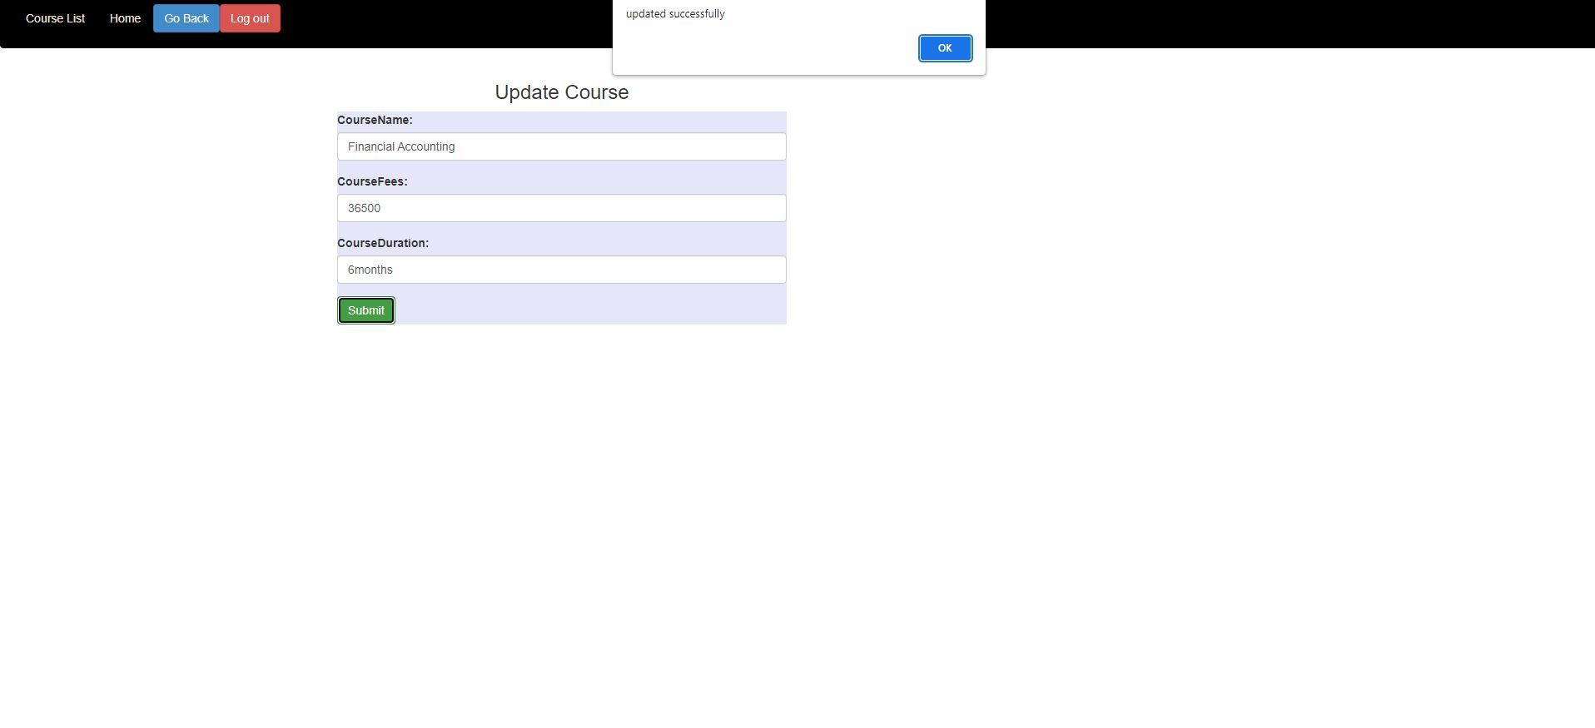
Update Course

Slide 27
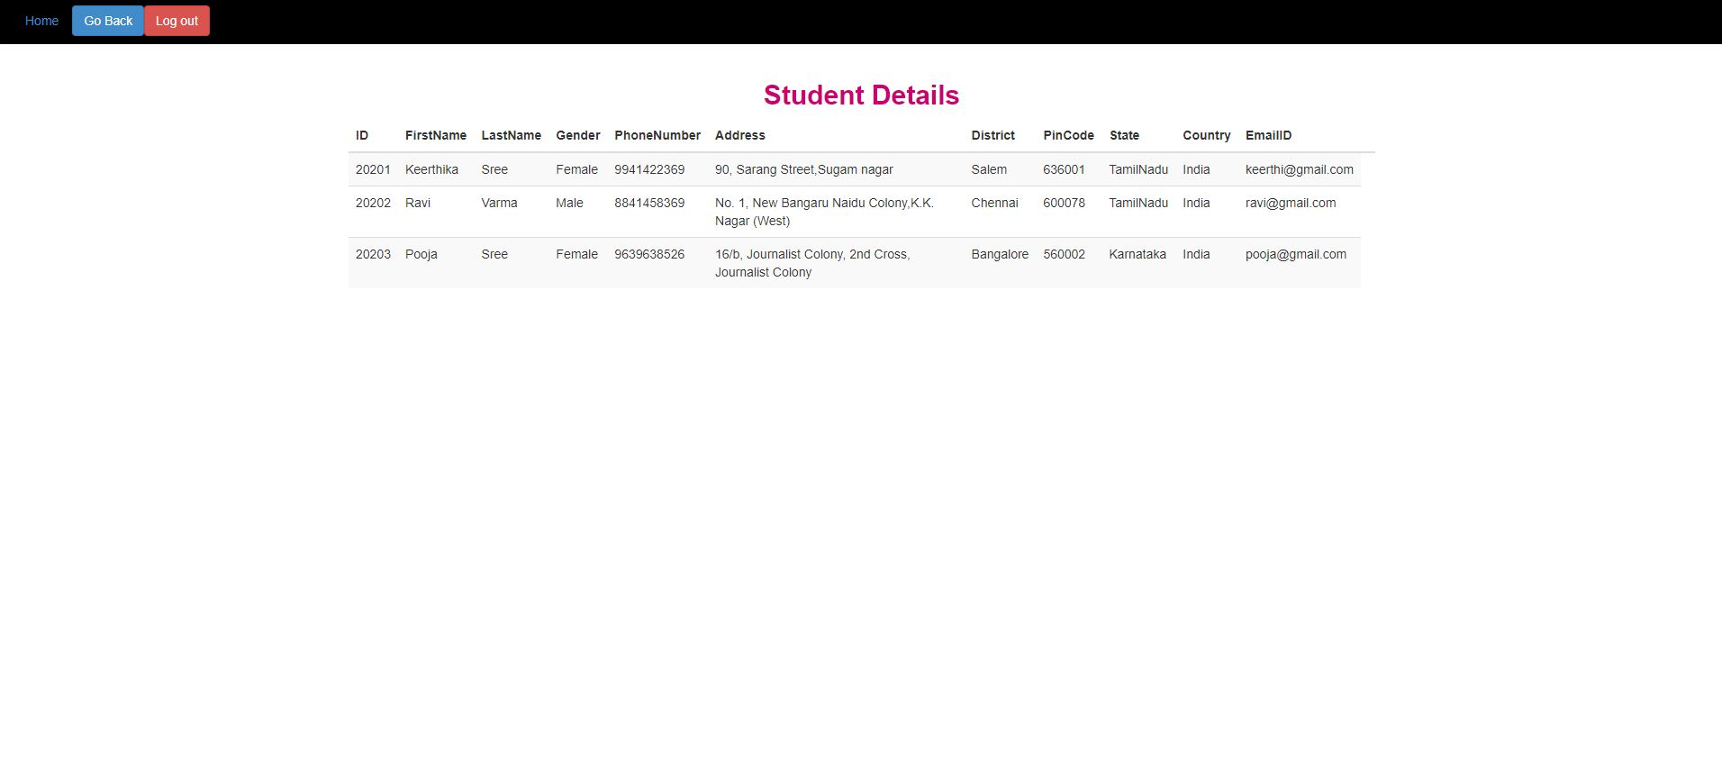
Student details

Slide 28
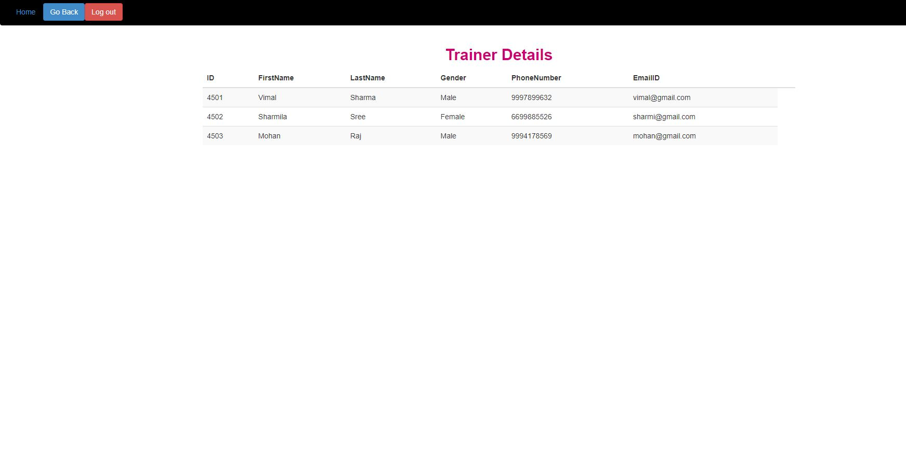
Trainer Details

Slide 29
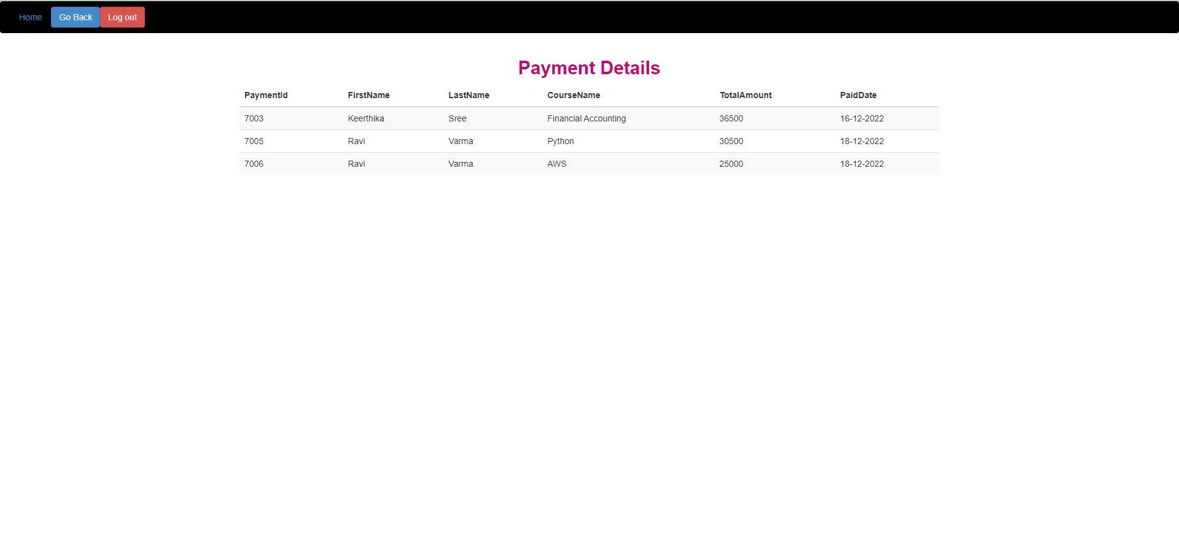
Payment Details

Slide 30
STUDENT

Slide 31
Student Login

Slide 32
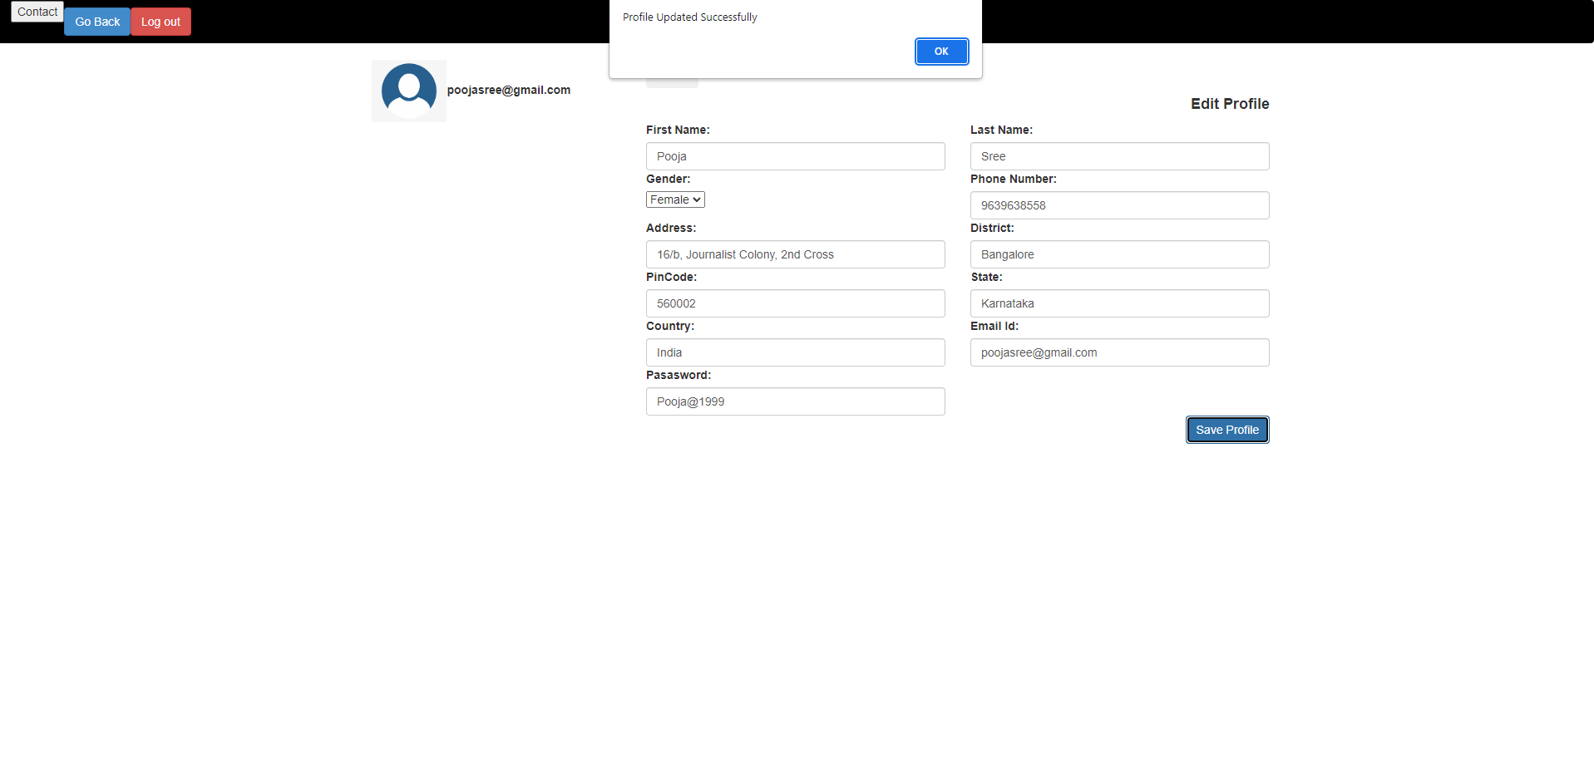
Profile

Slide 33
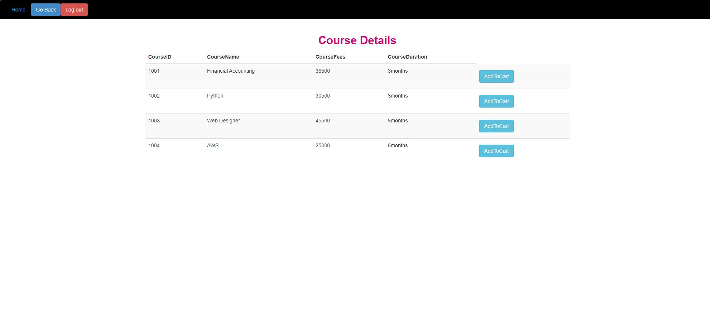
View Course

Slide 34
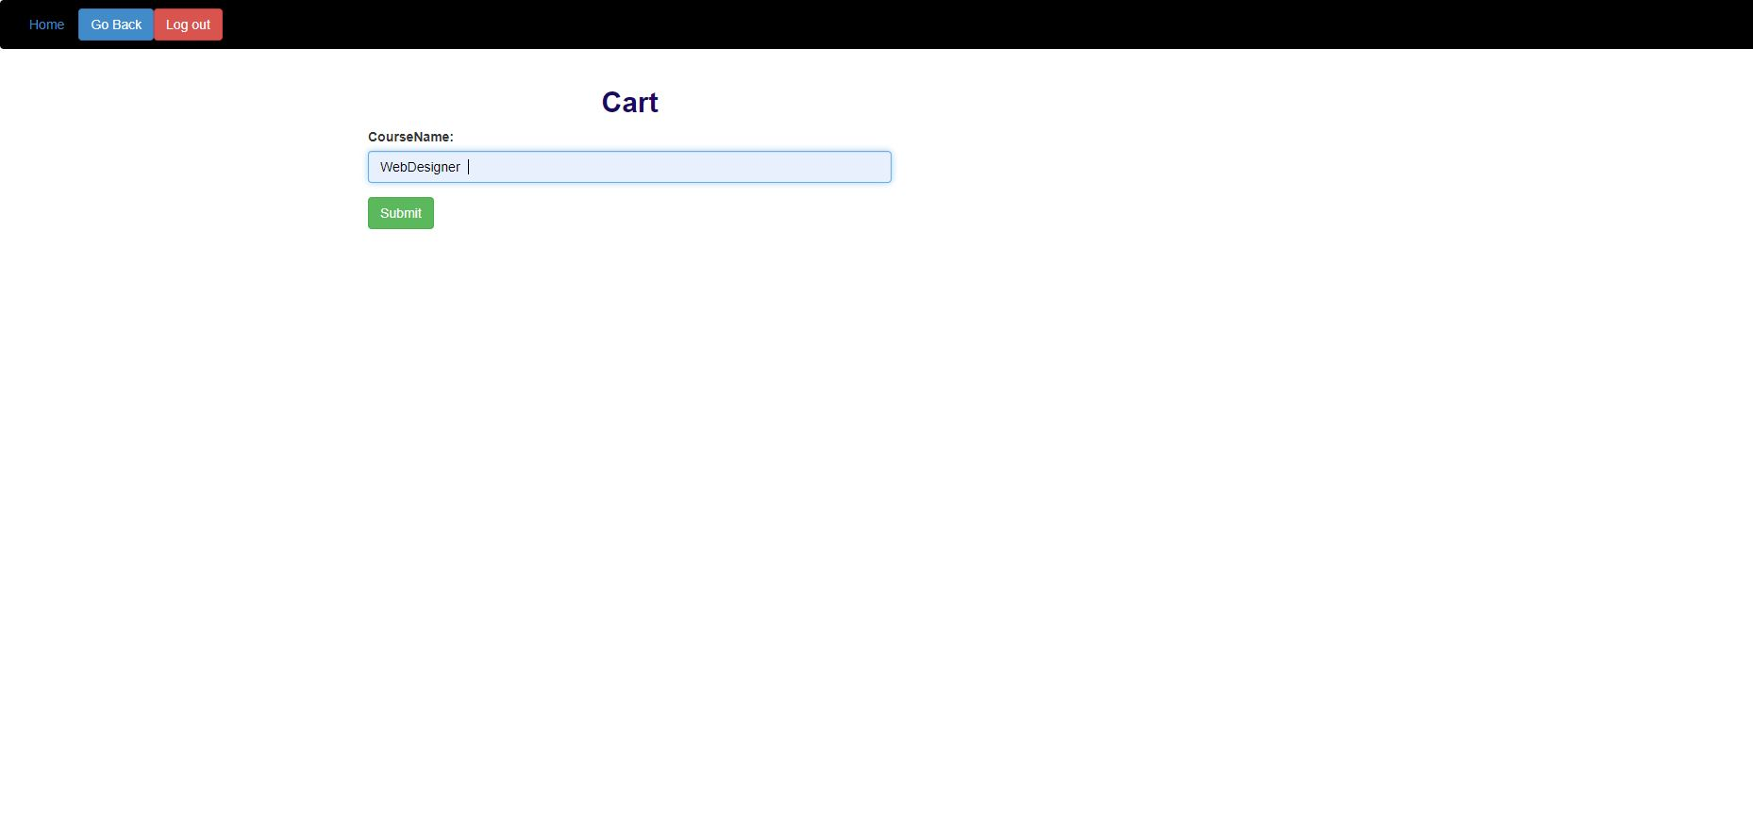
Add Course To Cart

Slide 35
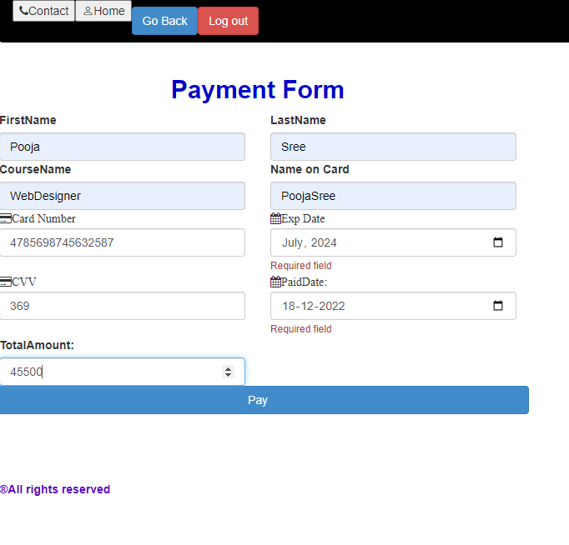
Payment Form

Slide 36
Trainer

Slide 37
Trainer Login

Slide 38
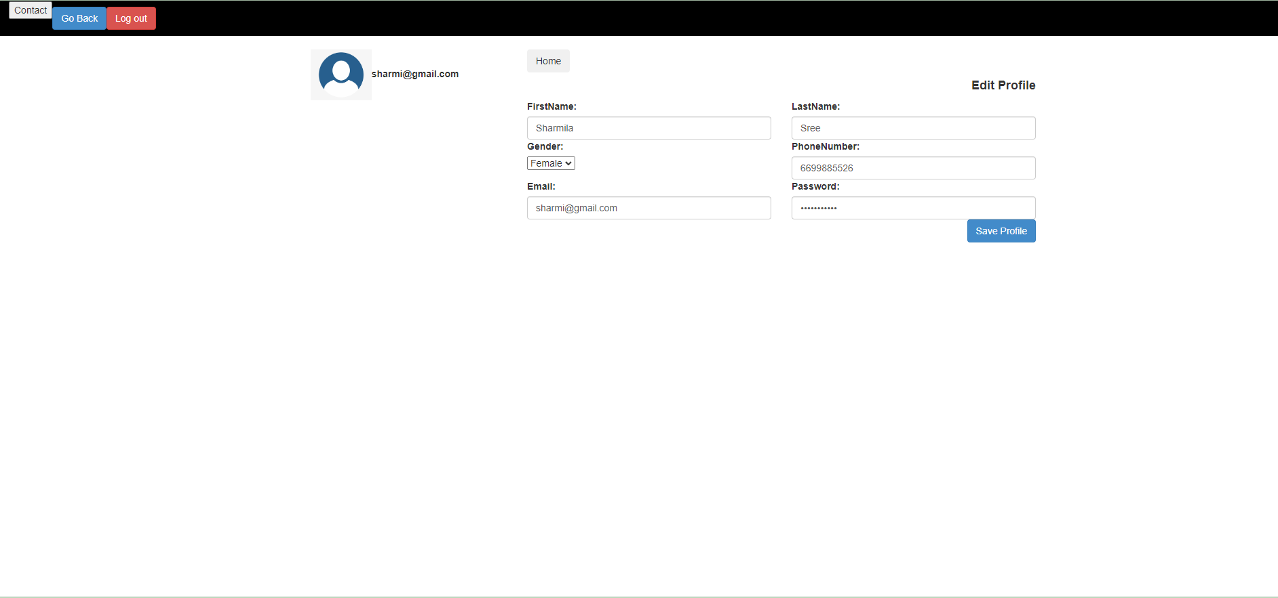
Trainer Profile

Slide 39
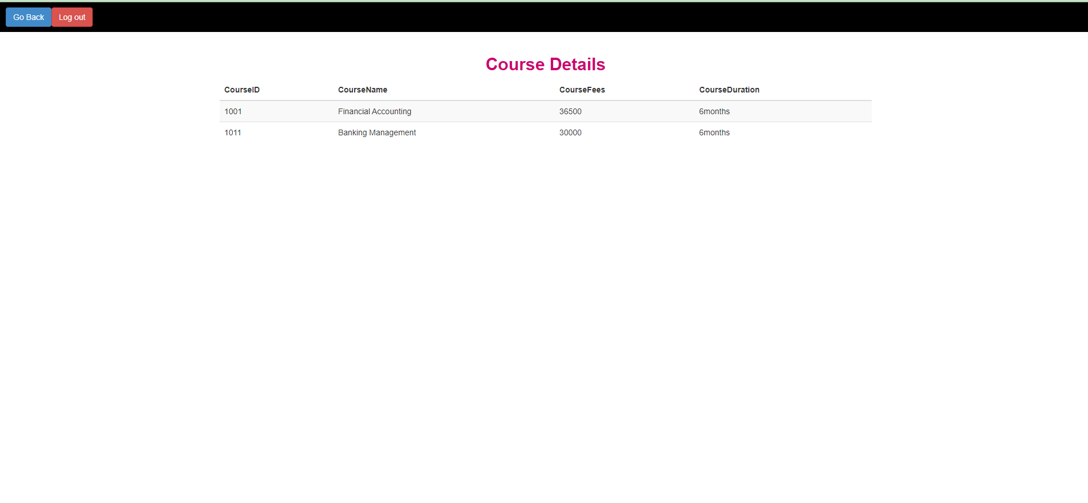
Course Details

Slide 40
REFERENCE
GOOGLE YOUTUBE

Slide 41
THANK YOU

